Slide 1
IMAGE ENCRYPTION & DECRYPTION USING JAVA
A project seminar on
By :
CSE 2018-21 Batch
Gyanapriya Pradhan
Asutosh Padhy
Mubarak Ahmed
Pratyush kumar Jena
Sandeep kumar
Under the Guidance of :
(Asst. Prof.) Mr. Amardeep Das

Slide 2
Content
1. Encryption and Decryption
2. Need of Image Encryption
3. Requirement of image Encryption
4 . Software information
5. Methodology
6. Algorithm
7. Project GUI Design
8. Modules
9. Test cases
10. Conclusion

Slide 3
WHAT IS ENCRYPTION ?
Encryption is a process which uses a finite set of instruction called an algorithm to convert original message, known as plaintext, into cipher text, its encrypted form. Cryptographic algorithms normally require a set of characters called a key to encrypt or decrypt data. With the help of key and the algorithm we can encrypt or Decrypt the plaintext into cipher text and then cipher text back into plaintext.

Slide 4
Need IMAGE ENCRYPTION ?
Nowadays, information security is becoming more important in data storage and transmission.
Images are widely used in different-different processes. Therefore, the security of image data from unauthorized uses is important.
Image encryption plays a important role in the field of information hiding.
Image encryption method prepared information unreadable. Therefore, no hacker or eavesdropper, including server administrators and others, have access to original message or any other type of transmitted information through public networks such as internet.

Slide 5
requirements OF IMAGE ENCRYPTION :
Create a strong encrypted image such that it cannot be hacked easily.
Ability to get the pixels of the original image to Encrypt.
Faster encryption and decryption.
Perfection in the original image we obtain after decrypting it.

Slide 6
SOFTWARE INFORMATION :
Oprating System : Windows
IDE : Netbeans and Visual studio code etc.
Coding Language : JAVA
Runtime path : JRE 8

Slide 7
Methodology:
Algorithm & Project Design:
In these cases also we will do the same, For encryption, we will convert the image into a byte array and after converting it we will apply algorithm XOR operation on each value of the byte array and after performing algorithm XOR operation on each and every value of byte array will be changed. After performing the operation now we will write new data in Image due to which we are unable to open the Encrypted Image. Here are key will act as a password to Encrypt and Decrypt the Image.
XOR Operation:
As we know that how to perform XOR operation now we will see how XOR operation will work here. Let’s consider an example of sample input and output.

Slide 8
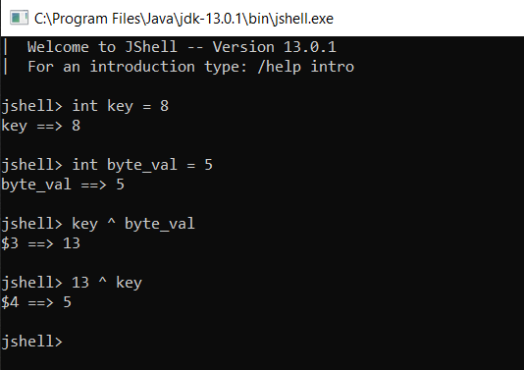
Here, is the screenshot of the above example. Let’s have a look

Slide 9
GUI Building :
Java Extension and toolkit packages are used :
AWT (abstract Windowing tool): TextField, Label, TextArea, RadioButton, CheckBox, Choice, List etc.
JAVA Swing : JButton, JTextField, JTextArea, JRadioButton, JColorChooser,Jframe,Jbutton (with actionlistener) Jtextfield , Jpanel , Jfilechooser etc.
JAVA I/O : file input and file output stream to get the file into the GUI for operation.

Slide 10
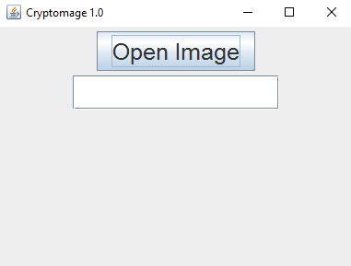
Project GUI :
Cryptomage 1.0 is a formal name given to the GUI .

Slide 11
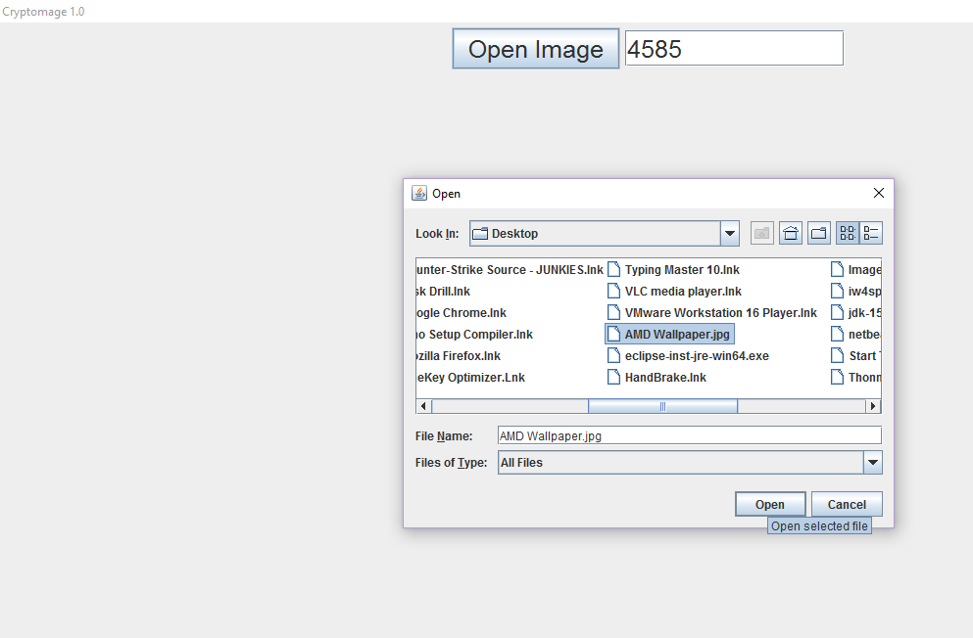
Using of Cryptomage 1.0 :
Encryption : Entre A Numerical Key like eg. 4858 for passkey & Select the image file Click Open .
Decryption : Do the same process with same Numerical Key/passkey and also select the same image file .
[ DONE ]

Slide 12
Modules :
User Module :
Run the Program in any java IDE
GUI will Open
Select the image file to be Executed
Encryption Module :
Provide any Numerical Character Keyword for Encryption
Select the image by clicking open image button
Encryption is Done.
Decryption Module :
Provide the same numerical character keyword as you provided before while Encrypting.
Select the same Image open image Button.
Decryption is done.

Slide 13

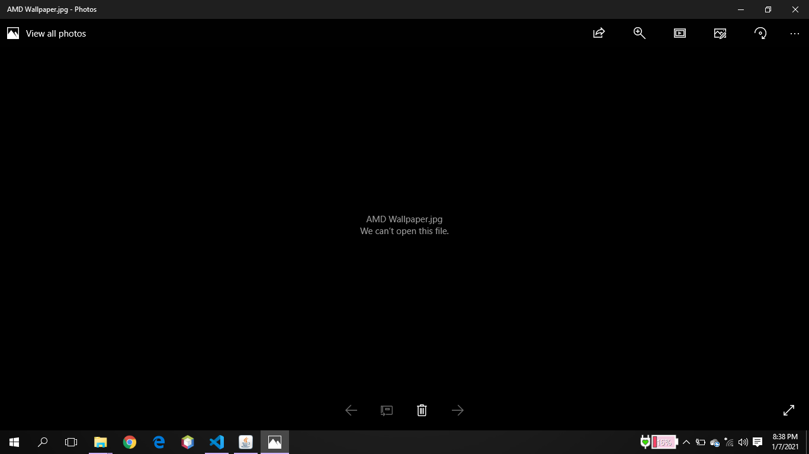
Test Cases : case 1.
AFTER ENCRYPTION :

Slide 14
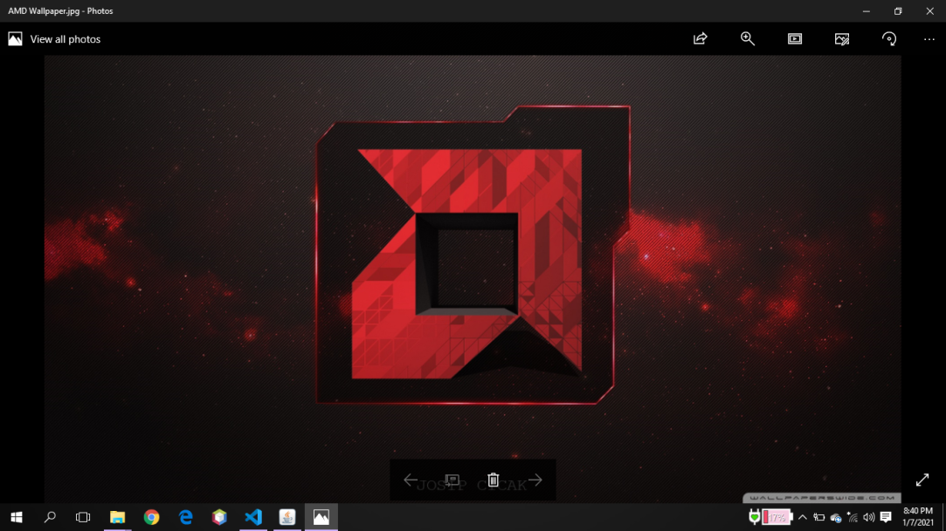
Case 2.
AFTER DECRYPTION :

Slide 15
Conclusion :
Thus, the project entitled “Image Encryption and Decryption using java ” was successfully completed. A simplex project involving the conversion of image into Bitwise form, using a mathematical concept to encrypt and decrypt it a same way,it was instrumental in giving us a thorough understanding of how the concepts of XOR Operation in java can actually be implemented in the real world. By the end of the project, we have gained valuable skills including a grounding of how to interact with the Java IDE, GUI making in java, algorithms, calculating the efficiencies and learning how to form and manipulate images.

Slide 16
THANK YOU

